Slide 1

The χ2 Test
Dr Lee Barnby
School of Computing
7MA505 Statistical Techniques
Week 6, Autumn Semester

Slide 2
Outline
Analysing categorised data
  Simple Example: Drink Preference
  Further Example: Disease Behaviour link
Goodness of fit tests
  Industrial accident example

Slide 3
Analysis of categorised data
An investigation may be concerned with classifying respondents into groups
For two measured variables the results can be presented in a two-way frequency table
  Also known as a contingency table
  The number of classifications is dependent on what is being surveyed

Slide 4
Let’s collect some data!
Do you prefer tea or coffee?
  This is a medium size class so we may have enough people to create a meaningful survey.
  Options let you identify as Male or Female and indicate whether you prefer coffee, tea or don’t like hot drinks/prefer something else (3 options)
Let’s create a contingency table by recording whether each person is male or female AND whether they prefer tea of coffee.

Slide 5
Survey link
https://pollev.com/leebarnby840

Slide 6
Tea or coffee drinker?
In an opinion survey, a random sample of 1000 people students in the class were asked if they preferred Tea or Coffee.
 | Tea | Coffee | Total
Male
Female
Total

Slide 7
Tea or coffee drinker?
In an opinion survey, a random sample of 1000 people were asked if they preferred Tea or Coffee. (In case our data collection goes wrong)
 | Tea | Coffee | Total
Male | 260 | 140 | 400
Female | 440 | 160 | 600
Total | 700 | 300 | 1000

Slide 8
Probability Notes
Binomial Distribution
  Two outcomes to choose from, e.g. coin toss – heads or tails
Multinomial Distribution
  k categories to choose from
  Probability of selecting category i is p_{i} , where 1 ≤ i ≤ k
  We require p₁ + p₂ + p₃ + … p_{k} = 1
  Example: when p_{i} = 1/k for dice roll

Slide 9
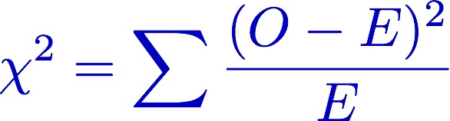
χ² Statistic – applied to drink preference
Is there a difference between the genders with regard to preference?
If no difference between the genders in the whole population, then as 0.7 (700/1000) of the sample (regardless of gender) prefer Tea, then we would expect
  0.7 of the men to prefer Tea, 0.7 × 400 = 280
  0.7 of the women to prefer Tea, 0.7 × 600 = 420
The overall relative difference between the observed and expected frequencies is found by calculating the test statistic
O = observed frequency
E = expected frequency

Slide 10
χ² features
If there was no difference between the genders with regard to preference, the value of the Test Statistic would follow a Chi-Squared (χ²) Distribution
To check whether the difference between the two sets of frequencies is due only to sampling errors, the value of the Test Statistic is compared to Critical Values of the χ² distribution
  At the chosen level of significance (95%, 99% etc.)
Tables come in different sizes, there are different distributions for different “table sizes”

Slide 11
χ² continued
The specific χ2 Distribution is defined by its Degrees of Freedom
Defined by (r-1) × (c-1)
  Where r is number of rows and c is number of columns
The χ² Distribution should only be used if every expected frequency is equal or greater than 5
  Sometimes columns or rows may be combined to achieve this (but they have to be meaningful/sensible combinations)

Slide 12
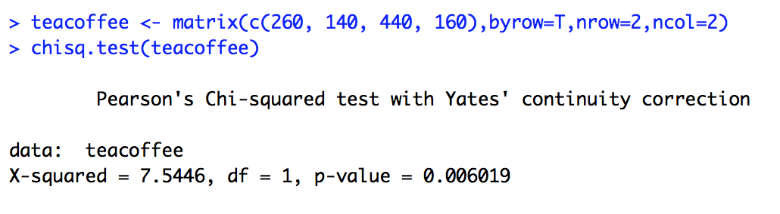
Drinks preference in R
Null hypothesis: independence. i.e. males and females proportionately consume tea and coffee
Since p < 0.05, the chosen significance level, then the null hypothesis is rejected here

Slide 13
Disease-behaviour link
Example of lung disease with two categories for each variable
  Smoker/non-smoker, cancer/ no cancer
Investigation used cause of death
 | Smoker | Non-smoker | Total
Cancer | 94 | 26 | 120
Not Cancer | 506 | 374 | 880
Total | 600 | 400 | 1000

Slide 14
Analysis Steps
Note that the null hypothesis here goes against the established link between smoking and lung cancer
Null hypothesis: smoking habits and the occurrence of cancer are independent.
Alternative hypothesis: the occurrence of cancer is related to smoking habits.
Choose a significance level. 5% is used in this example.
If the null hypothesis is true the cell frequency should have some relation to the column and row totals.

Slide 15
Calculate expected frequency table
Use the ratio from the totals row
 | Smoker | Non-smoker | Total
Cancer |  |  | 120
Not Cancer |  |  | 880
Total | 600 | 400 | 1000

Slide 16
Calculate χ²
The test statistic would be zero if the contingency table exactly followed the expected value table
We know however, that the expected values are hardly ever obtained in practice
But the actual data should be fairly near these values if our null hypothesis is to be believed.

Slide 17
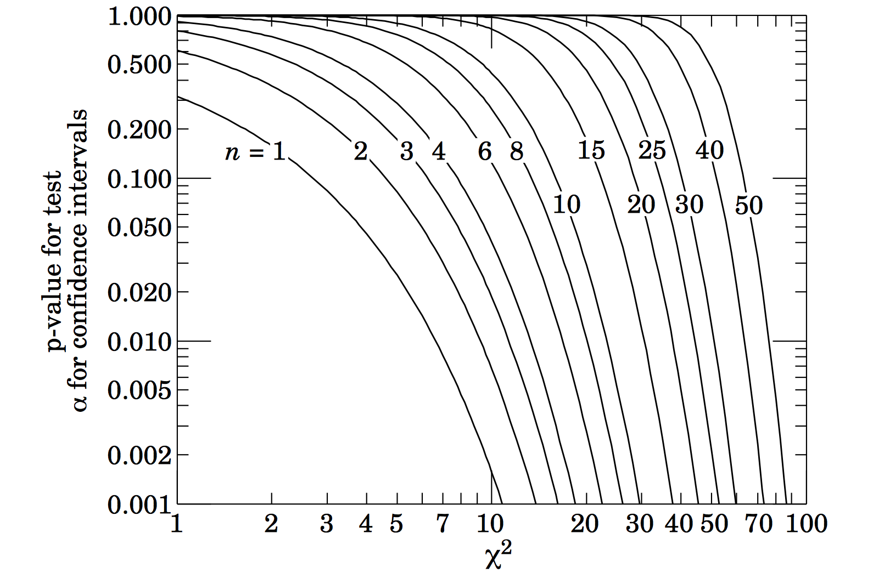
Relate to hypothesis
Degrees of Freedom =
(number of rows in the table: 1) ×
(number of columns in the table: 1)
Using the χ² table the critical value with 1 degree of freedom at a 5% significance level is 3.841
  19.1 > 3.841 so p will be very small
The null hypothesis is therefore rejected (because p < 0.05).
We conclude that cancer and smoking are not independent; they are related.

Slide 18
Goodness of Fit Tests
Day | N accidents | N expected | χ² contribution
Monday | 57
Tuesday | 42
Wednesday | 48
Thursday | 53
Friday | 41
Saturday | 59
The Chi-squared distribution can be used when testing if a variable can be assumed to follow a stated distribution
Example with industrial accidents:
Is there evidence to believe that in the long run the number of accidents recorded is related to the day of the week?

Slide 19
Conclusion
We now have a technique to use on categorical data, to check their co-dependence.
It can be extended to look at fits to theoretical expectations

Slide 20
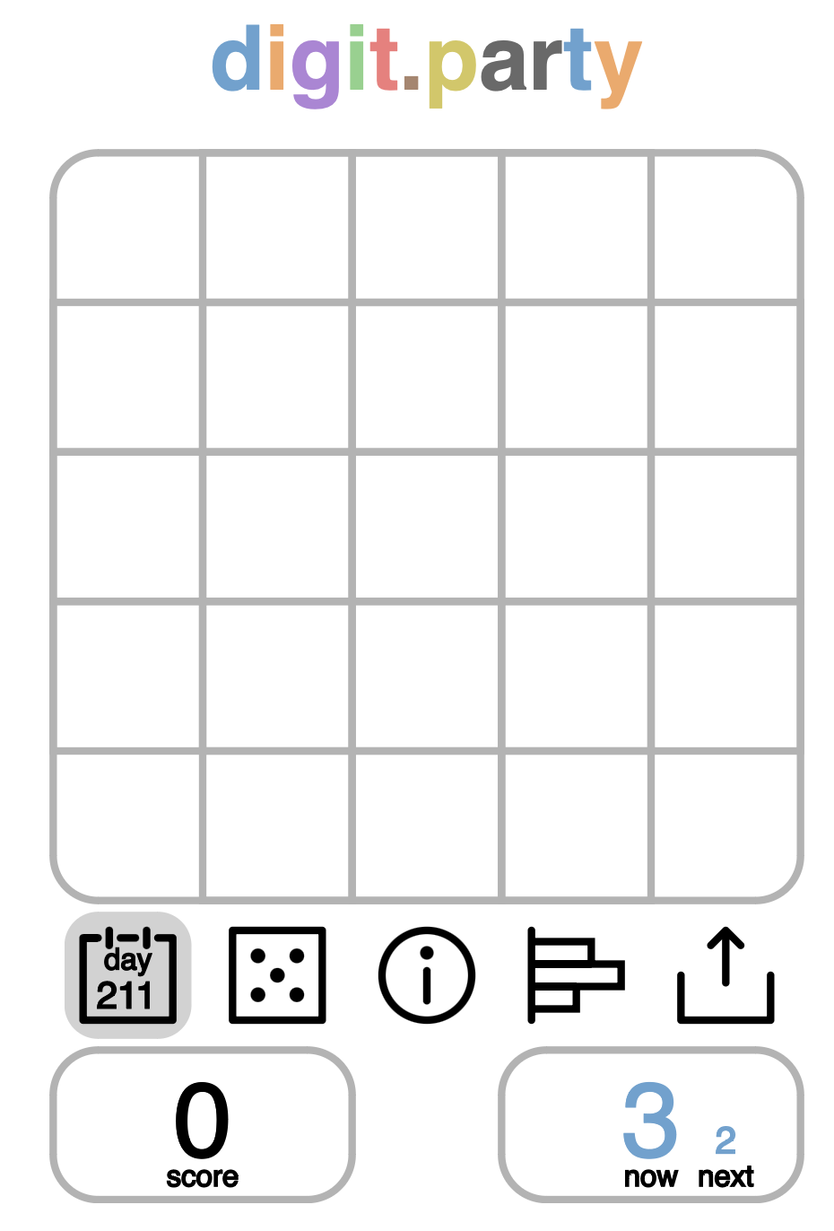
Bonus example
My results in the game digit.party
  The game involves putting numbers 1-9 into a 5 x 5 grid so that the same digits are continuous to get points from links
  The numbers appear to be random both in sequence and content i.e. there are differing numbers of each digit
  You can see the next and subsequent digits
  It is easier to demonstrate than explain!

Slide 21
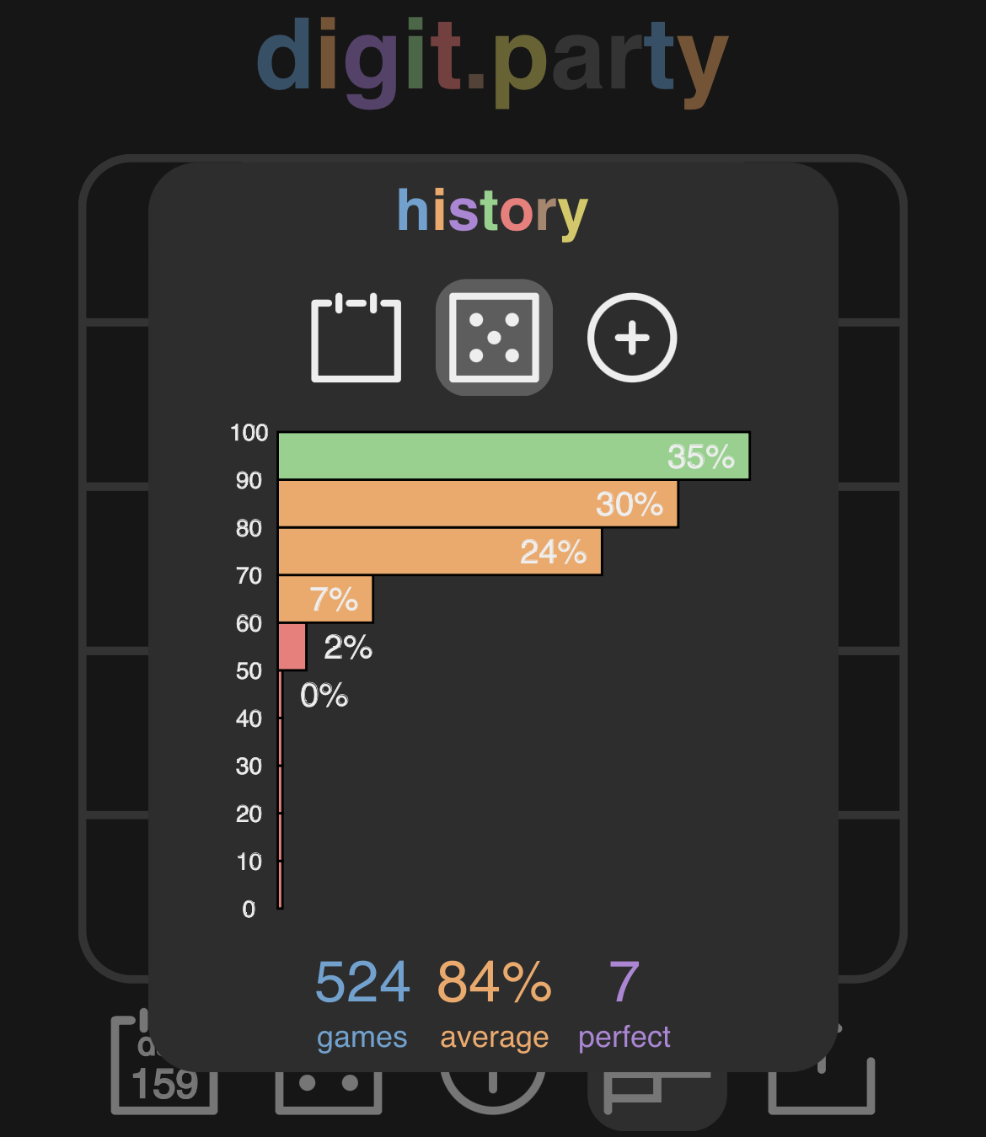
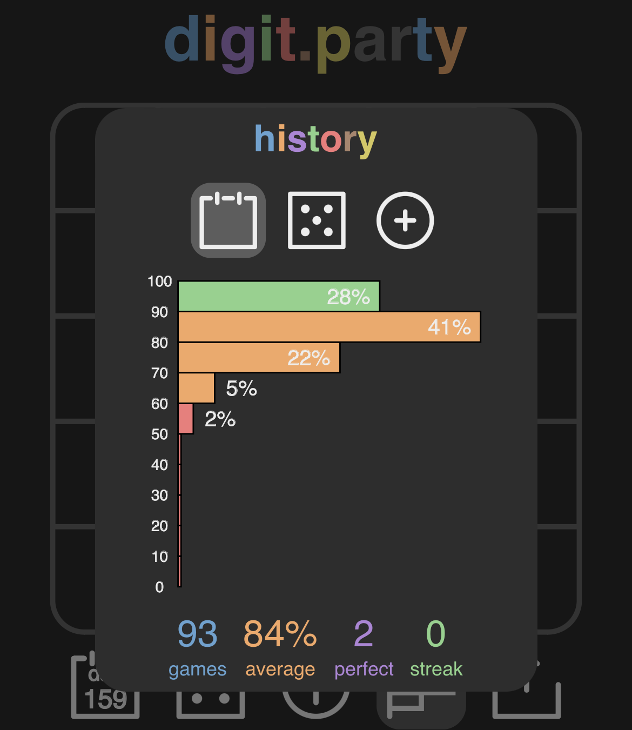
Bonus example cont.
I like to have a few practice goes before completing the daily puzzle. Is this strategy effective?
I have a summary of scores from each case. They show the percentage of games in several bands; 90-100%, 80-89%, 70-79%, 60-70% …
Practice
Daily puzzle

Slide 22
Analysis
Result | 90-100% | 80-89% | 70-79% | 60-69% | 0-60%
Daily Puzzle
Practice
What numbers should you fill the table with?

